Slide 1
CST204 Database Management System
Module 4

Slide 2
Introduction
Syllabus – Overview
Module 1 : Introduction and Entity Relationship (ER) model
Module 2 : Relational Model
Module 3 : SQL DML and Physical Data Organization
Module 4 : Normalization
Module 5: Transaction, concurrency and recovery, recent topics

Slide 3
Introduction
Syllabus – Module 4
Different anomalies in designing a database
The idea of normalization
Functional dependency
Armstrong’s Axioms (proofs not required)
Closures and their computation
Equivalence of Functional Dependencies (FD)
Minimal Cover (proofs not required)
First Normal Form (1NF)
Second Normal Form (2NF)
Third Normal Form (3NF)
Boyce Codd Normal Form (BCNF)
Lossless join and dependency preserving decomposition
Algorithms for checking Lossless Join (LJ) and Dependency Preserving (DP) properties

Slide 4
Normalization
Anomalies
Anomalies are caused when there is too much redundancy in the database's information
Anomalies can often be caused when the tables that make up the database suffer from poor construction
Poor table design will become evident if, when the designer creates the database, he doesn't identify the entities that depend on each other for existence
There are three types of Data Anomalies: Update Anomalies, Insertion Anomalies, and Deletion Anomalies

Slide 5
Normalization
Types of Anomalies
Update Anomalies
It happen when the person charged with the task of keeping all the records current and accurate, is asked, for example, to change an employee’s title due to a promotion
If the data is stored redundantly in the same table, and the person misses any of them, then there will be multiple titles associated with the employee
The end user has no way of knowing which is the correct title
Let say we have 10 columns in a table out of which 2 are called employee Name and employee address

Slide 6
Normalization
Types of Anomalies
Update Anomalies
Now if one employee changes it’s location then we would have to update the table
But the problem is, if the table is not free from anomalies one employee can have multiple entries and while updating all of those entries one of them might get missed

Slide 7
Normalization
Types of Anomalies
Insert Anomalies
It happen when inserting vital data into the database is not possible because other data is not already there
For example, if a system is designed to require that a customer be on file before a sale can be made to that customer, but we cannot add a customer until they have bought something, then we have an insert anomaly
Another example is, suppose Jerry is a new Student with department id 6
There is no Department with this Dept_ID 6
Hence , the anomaly
The usual behaviour should be a new department id with 6 and only then student could have it

Slide 8
Normalization
Types of Anomalies
Deletion Anomalies
Deletion Anomalies happen when the deletion of unwanted information causes desired information to be deleted as well
For example, if a single database record contains information about a particular product along with information about a salesperson for the company and the salesperson quits, then information about the product is deleted along with salesperson information
Let’s say we have student’s information and courses they have taken as follows (student ID,Student Name, Course, address)

Slide 9
Normalization
Types of Anomalies
Deletion Anomalies
If any student leaves the school then the entry related to that student will be deleted
However, that deletion will also delete the course information even though course depends upon the school and not the student

Slide 10
Normalization
Types of Anomalies
Deletion Anomalies
If any student leaves the school then the entry related to that student will be deleted
However, that deletion will also delete the course information even though course depends upon the school and not the student
Redundancy is the root cause of all anomalies existing in database
In order to escape from anomalies, we use a technique called normalization
Normalization is the process of organizing the data in the database

Slide 11
Normalization
Normalization
Normalization is the process of organizing the data in the database
Normalization is used to minimize the redundancy from a relation or set of relations
It is also used to eliminate the undesirable characteristics like Insertion, Update and Deletion Anomalies
Normalization divides the larger table into the smaller table and links them using relationship
The normal form is used to reduce redundancy from the database table
Redundancy means the duplication of data i.e., same data is occurring multiple times in database
For normalization we use two concepts – keys and functional dependency

Slide 12
Normalization
Normalization - Keys
Keys in DBMS are used to identify each rows/tuples/records uniquely
With respect to below table, we have following keys
Super Key
They are used to identify each rows/tuples/records uniquely
Maximum super keys in any relation is 2^{n} - 1

Slide 13
Normalization
Normalization - Keys
Candidate Key
It is a super key whose proper subset is not a super key
It is a minimal super key
Primary Key
It is the one candidate key which has no null value
Remaining candidate keys are called secondary key or alternate keys
In every relation we have many super keys and candidate keys but only one primary key

Slide 14
Normalization
Normalization - Keys
In a relation R(A, B, C); A is the candidate key. Find the number of super keys in the relation
If A is the candidate key
Then the super keys will be A, AB, AC, ABC = 4
If AC is the candidate key
Then the super keys will be AC, ACB = 2

Slide 15
Normalization
Normalization – Functional Dependencies
Functional Dependency is a set of constraints on various attributes of a relational
It is used to specify a formal measure of the ‘goodness’ of relational designs
It is a constraint between two sets of attributes
Functional Dependency and keys are used to define normal forms for relations
Let R = {A1, A2, …., An}
A set of attributes X functionally determines a set of attributes Y if the value of X determines a unique value for Y

Slide 16
Normalization
Normalization – Functional Dependencies
It is denoted by X -> Y
It means between two sets of attributes X and Y that are subsets of R specifies a constraint on the possible tuples
For example, employee_id → name means employee_id functionally determines the name of the employee
As another example in a timetable database, {student_id, time} → {lecture_room}, student ID and time determine the lecture room where the student should be
A function dependency A → B means for all instances of a particular value of A, there is the same value of B

Slide 17
Normalization
Normalization – Functional Dependencies
For example in the below table A → B is true, but B → A is not true as there are different values of A for B = 3

Slide 18
Normalization
Normalization – Functional Dependencies
There are two types of functional dependencies – trivial functional dependency and non – trivial functional dependency

Slide 19
Normalization
Normalization – Trivial Functional Dependencies
A → B has trivial functional dependency if B is a subset of A
The following dependencies are also trivial like: A → A, B → B
Consider a table with two columns Employee_Id and Employee_Name then
{Employee_id, Employee_Name} → Employee_Id is a trivial functional dependency as Employee_Id is a subset of {Employee_Id, Employee_Name}
Also, Employee_Id → Employee_Id and Employee_Name → Employee_Name are trivial dependency

Slide 20
Normalization
Normalization – Non -Trivial Functional Dependencies
A → B has a non-trivial functional dependency if B is not a subset of A
For example, ID → Name and Name → DOB is non – trivial functional dependency

Slide 21
Normalization
Normalization – Armstrong’s Axioms
The Armstrong's axioms are the basic inference rule
Armstrong's axioms are used to conclude functional dependencies on a relational database
The inference rule is a type of assertion
It can apply to a set of FD(functional dependency) to derive other FD
Using the inference rule, we can derive additional functional dependency from the initial set
The Functional dependency has 6 types of inference rule

Slide 22
Normalization
Normalization – Armstrong’s Axioms – Inference Rules
Reflexive Rule (IR1)
In the reflexive rule, if Y is a subset of X, then X determines Y
If X ⊇ Y then X → Y
Example:
X = {a, b, c, d, e}
Y = {a, b, c}

Slide 23
Normalization
Normalization – Armstrong’s Axioms – Inference Rules
Augmentation Rule (IR2)
The augmentation is also called as a partial dependency
In augmentation, if X determines Y, then XZ determines YZ for any Z
If X → Y then XZ → YZ
Example:
For R(ABCD), if A → B then AC → BC

Slide 24
Normalization
Normalization – Armstrong’s Axioms – Inference Rules
Transitive Rule (IR3)
In the transitive rule, if X determines Y and Y determine Z, then X must also determine Z
If X → Y and Y → Z then X → Z
Union Rule (IR4)
Union rule says, if X determines Y and X determines Z, then X must also determine Y and Z
If X → Y and X → Z then X → YZ

Slide 25
Normalization
Normalization – Armstrong’s Axioms – Inference Rules
Decomposition Rule (IR5)
Decomposition rule is also known as project rule
It is the reverse of union rule
This Rule says, if X determines Y and Z, then X determines Y and X determines Z separately
If X → YZ then X → Y and X → Z
Pseudo transitive Rule (IR6)
In Pseudo transitive Rule, if X determines Y and YZ determines W, then XZ determines W
If X → Y and YZ → W then XZ → W

Slide 26
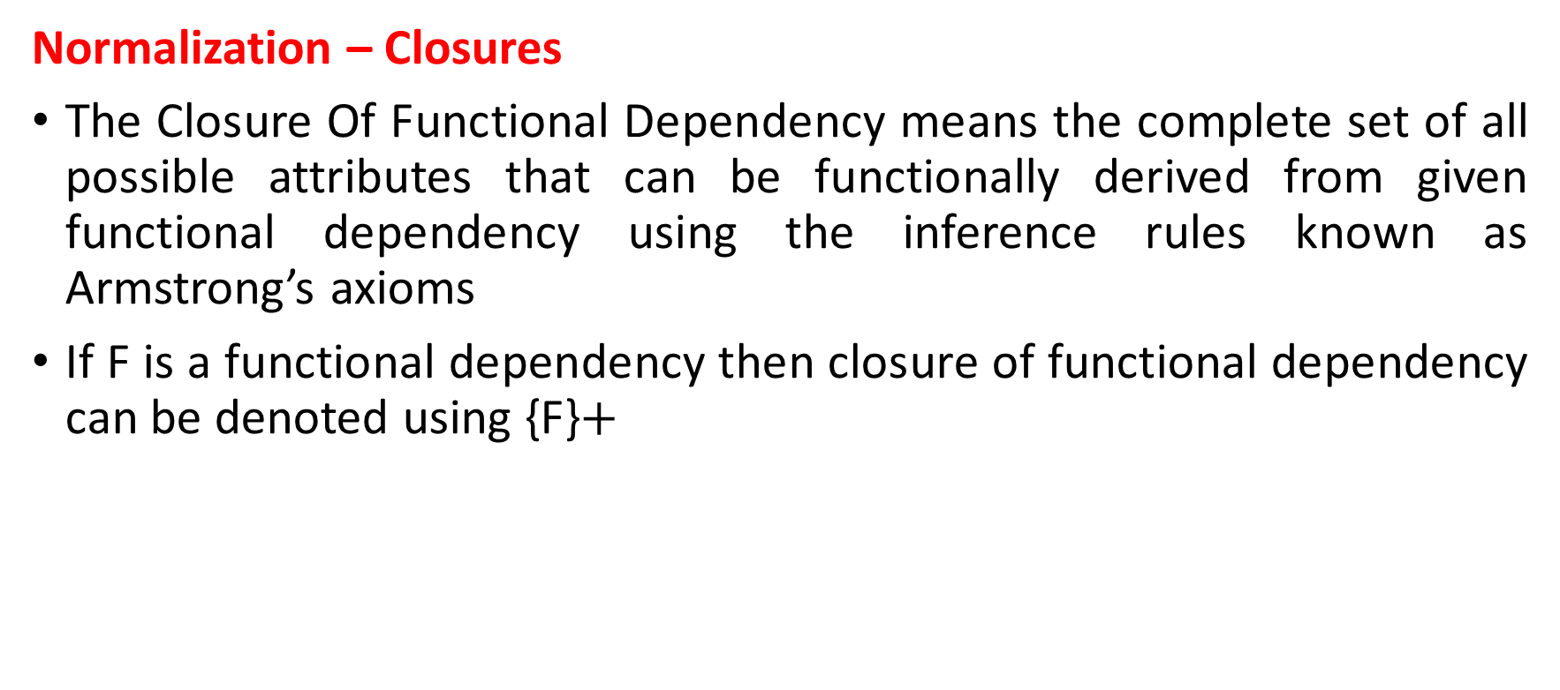
Normalization
Normalization – Closures
The Closure Of Functional Dependency means the complete set of all possible attributes that can be functionally derived from given functional dependency using the inference rules known as Armstrong’s axioms
If F is a functional dependency then closure of functional dependency can be denoted using {F}$+$

Slide 27
Normalization
Normalization – Closures
Find the closures for relations R(A, B, C, D, E) with following functional dependencies FD {A→B, B→C, C→D, D→E}

Slide 28
Normalization
Normalization – Closures
Consider a relation R ( A , B , C , D , E , F , G ) with the functional dependencies-
A → BC
BC → DE
D → F
CF → G

Slide 29
Normalization
Normalization – Closures
A+ = { A }
= { A , B , C } ( Using A → BC )
= { A , B , C , D , E } ( Using BC → DE )
= { A , B , C , D , E , F } ( Using D → F )
= { A , B , C , D , E , F , G } ( Using CF → G )
Thus,
A+ = { A , B , C , D , E , F , G }

Slide 30
Normalization
Normalization – Closures
D+ = { D }
= { D , F } ( Using D → F )
We can not determine any other attribute using attributes D and F contained in the result set.
Thus,
D+ = { D , F }

Slide 31
Normalization
Normalization – Closures
{ B , C }+= { B , C }
= { B , C , D , E } ( Using BC → DE )
= { B , C , D , E , F } ( Using D → F )
= { B , C , D , E , F , G } ( Using CF → G )
Thus
{ B , C }+ = { B , C , D , E , F , G }

Slide 32
Normalization
Normalization – Closures
Finding the Keys Using Closure
Super Key
If the closure result of an attribute set contains all the attributes of the relation, then that attribute set is called as a super key of that relation
Thus, we can say that the closure of a super key is the entire relation schema
In the previous example, the closure of attribute A is the entire relation schema
Thus, attribute A is a super key for that relation

Slide 33
Normalization
Normalization – Closures
Candidate Key-
If there exists no subset of an attribute set whose closure contains all the attributes of the relation, then that attribute set is called as a candidate key of that relation
In the previous example,
No subset of attribute A contains all the attributes of the relation
Thus, attribute A is also a candidate key for that relation

Slide 34
Normalization
Normalization – Equivalence of Functional Dependency
In DBMS, two different sets of functional dependencies for a given relation may or may not be equivalent
If R1 and R2 are the two sets of functional dependencies, then following 3 cases are possible-
1. If all Functional dependencies of R1 can be derived from Functional dependencies present in R2, we can say that R2 is a subset of R1 (R2 ⊃ R1).
2. If all Functional dependencies of R2 can be derived from Functional dependencies present in R1, we can say that R1 is a subset of R2 (R1 ⊃ R2).
3. If 1 and 2 both are satisfied, then R1 = R2.

Slide 35
Normalization
Normalization – Equivalence of Functional Dependency
Case 1) Determining Whether R2 ⊃ R1 or not
Step 1)
Take into consideration, the functional dependencies of set R1
For every functional dependency P→ Q, find by using the functional dependencies of set R1, the closure of P
Step 2)
Take into consideration, the functional dependencies of set R2
For every functional dependency P→ Q, find by using the functional dependencies of set R2, the closure of P
Step 3)
Compare the results of Step 1 and Step 2
If the functional dependency of set R2 has determined all those attributes that were determined by the functional dependencies of set R1, then it means R2 ⊃ R1
Thus, we conclude R2 is a subset of R1 (R2 ⊃ R1) otherwise not

Slide 36
Normalization
Normalization – Equivalence of Functional Dependency
Case 2) Determining Whether R1 ⊃ R2 or not
Step 1)
Take into consideration the functional dependencies of set R2
For every functional dependency P → Q, find by using the functional dependencies of set R2, the closure of P
Step 2)
Take into consideration the functional dependencies of set R1
For every functional dependency P → Q, find by using the functional dependencies of set R1, the closure of P
Step 3)
Compare the results of Step 1 and Step 2
If the functional dependency of set R1 has determined all those attributes that were determined by the functional dependencies of set R2, then it means R1 ⊃ R2
Thus, we conclude that R1 is a subset of R2 (R1 ⊃ R2) otherwise not

Slide 37
Normalization
Normalization – Equivalence of Functional Dependency
Case 2) Determining Whether R1 ⊃ R2 or not
Case 3) Determining Whether Both R1 and R2 satisfy each other or not
If R2 is a subset of R1 and R1 is a subset of R2, then both R1 and R2 satisfied each other
Thus, if both the above cases satisfied, we conclude that R1 = R2

Slide 38
Normalization
Normalization – Equivalence of Functional Dependency
A relation R (P, Q, U, S, and T) is having two functional dependencies sets R1 and R2, which is shown as
Set R1: Set R2:
P → C P → QU
PQ → U S → PT
S → T

Slide 39
Normalization
Normalization – Equivalence of Functional Dependency
Case 1) Determining Whether R2 ⊃ R1 or not
Step 1)
(P)+ = {P, Q, U} // closure of left side of P → QU using set R1
(S)+ = {P, Q, U, S, T} // closure of left side of S → PT using set R1
Step 2)
(P)+ = {P, Q, U} // closure of left side of P → QU using set R2
(S)+ = {P, Q, U, S, T} // closure of left side of S → PT using set R2
Step 3)
Comparing the results of Step 1 and Step 2, we find,
Functional dependencies of set R2 can determine all the attributes which have been determined by the functional dependencies of set R1
Thus, we conclude R2 is a subset of R1 i.e. R2 ⊃ R1

Slide 40
Normalization
Normalization – Equivalence of Functional Dependency
Case 2) Determining Whether R1 ⊃ R2 or not
Step 1)
(P)+ = {P, Q, U} // closure of left side of P→ Q using set R2
(PQ)+ = {P, Q, U} // closure of left side of PQ → U using set R2
(S)+ = {P, Q, U, S, T} // closure of left side of S → PU and S → T using set R2
Step 2)
(P)+ = {P, Q, U} // closure of left side of P→ Q using set R1.
(PQ)+ = {P, Q, U} // closure of left side of PQ → U using set R1.
(S)+ = {P, Q, U, S, T} // closure of left side of S → PU and S → T using set R1
Step 3)
Comparing the results of Step 1 and Step 2, we find,
Functional dependencies of set R1 can determine all the attributes which have been determined by the functional dependencies of set R2
Thus, we conclude R1 is a subset of R2 i.e. R1 ⊃ R2

Slide 41
Normalization
Normalization – Equivalence of Functional Dependency
Case 3) Determining Whether Both R1 and R2 satisfy each other or not
From Step 1, we conclude R2 ⊃ R1
From Step 2, we conclude R1 ⊃ R2
Thus, we conclude that both R1 and R2 satisfied each other i.e. R1 = R2

Slide 42
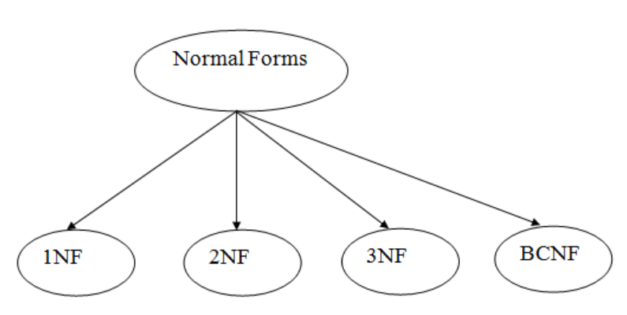
Normalization
Normalization – Normal Forms
There are four types of Normalization

Slide 43
Normalization
Normalization - First Normal Form (1NF)
A relation will be 1NF if it contains an atomic value
It states that an attribute of a table cannot hold multiple values
It must hold only single-valued attribute
First normal form disallows the multi-valued attribute, composite attribute, and their combinations
Example: Relation EMPLOYEE is not in 1NF because of multi-valued attribute EMP_PHONE

Slide 44
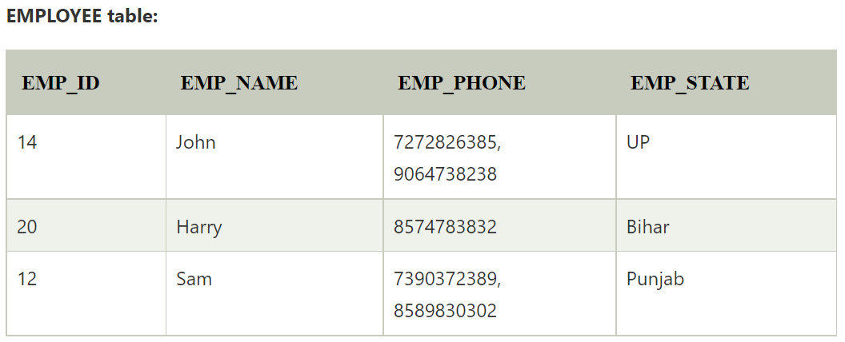
Normalization
Normalization - First Normal Form (1NF)

Slide 45
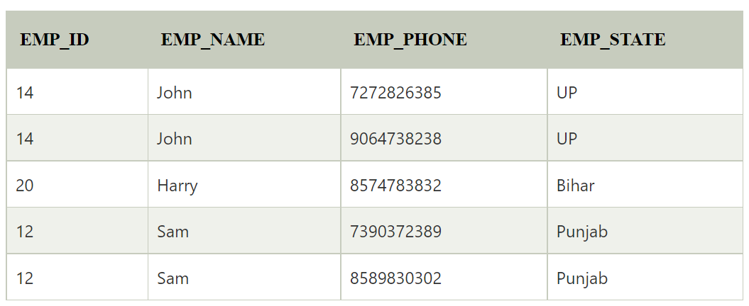
Normalization
Normalization - First Normal Form (1NF)
Decomposition of the EMPLOYEE table into 1NF has been shown below

Slide 46
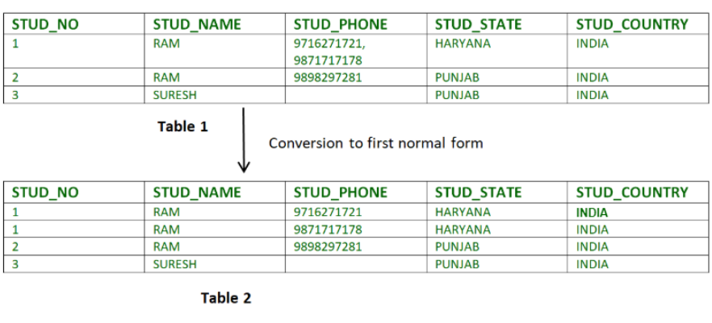
Normalization
Normalization - First Normal Form (1NF)
Relation STUDENT in table 1 is not in 1NF because of multi-valued attribute STUD_PHONE. Its decomposition into 1NF has been shown in table 2

Slide 47
Normalization
Normalization - Second Normal Form (2NF)
To be in second normal form, a relation must be in first normal form and relation must not contain any partial dependency
A relation is in 2NF if it has No Partial Dependency, i.e., no non-prime attribute (attributes which are not part of any candidate key) is dependent on any proper subset of any candidate key of the table
Partial Dependency – If the proper subset of candidate key determines non-prime attribute, it is called partial dependency

Slide 48

Normalization
Normalization - Second Normal Form (2NF)
Example 1 – Consider table-3 as following below
Note that, there are many courses having the same course fee

Slide 49
Normalization
Normalization - Second Normal Form (2NF)
Here, COURSE_FEE cannot alone decide the value of COURSE_NO or STUD_NO;
COURSE_FEE together with STUD_NO cannot decide the value of COURSE_NO;
COURSE_FEE together with COURSE_NO cannot decide the value of STUD_NO;
Hence, COURSE_FEE would be a non-prime attribute, as it does not belong to the one only candidate key {STUD_NO, COURSE_NO} ;
But, COURSE_NO -> COURSE_FEE , i.e., COURSE_FEE is dependent on COURSE_NO, which is a proper subset of the candidate key
Non-prime attribute COURSE_FEE is dependent on a proper subset of the candidate key, which is a partial dependency and so this relation is not in 2NF

Slide 50
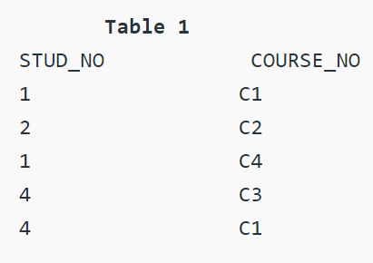

Normalization
Normalization - Second Normal Form (2NF)
To convert the above relation to 2NF, we need to split the table into two tables such as :
Table 1: STUD_NO, COURSE_NO
Table 2: COURSE_NO, COURSE_FEE

Slide 51
Normalization
Normalization - Second Normal Form (2NF)
2NF tries to reduce the redundant data getting stored in memory
For instance, if there are 100 students taking C1 course, we don't need to store its Fee as 1000 for all the 100 records, instead once we can store it in the second table as the course fee for C1 is 1000

Slide 52
Normalization
Normalization - Third Normal Form (3NF)
A relation is in third normal form, if there is no transitive dependency for non-prime attributes as well as it is in second normal form
A relation is in 3NF if at least one of the following condition holds in every non-trivial functional dependency X –> Y
X is a super key
Y is a prime attribute (each element of Y is part of some candidate key)
Transitive dependency – If A->B and B->C are two FDs then A->C is called transitive dependency

Slide 53
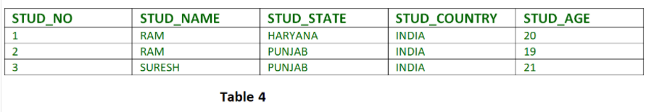
Normalization
Normalization - Third Normal Form (3NF)
Consider the table below:
FD set: {STUD_NO -> STUD_NAME, STUD_NO -> STUD_STATE, STUD_STATE -> STUD_COUNTRY, STUD_NO -> STUD_AGE}
Candidate Key: {STUD_NO}

Slide 54
Normalization
Normalization - Third Normal Form (3NF)
For this relation in table 4, STUD_NO -> STUD_STATE and STUD_STATE -> STUD_COUNTRY are true
So STUD_COUNTRY is transitively dependent on STUD_NO
It violates the third normal form. To convert it in third normal form, we will decompose the relation STUDENT (STUD_NO, STUD_NAME, STUD_PHONE, STUD_STATE, STUD_COUNTRY_STUD_AGE) as:
STUDENT (STUD_NO, STUD_NAME, STUD_PHONE, STUD_STATE, STUD_AGE)
STATE_COUNTRY (STATE, COUNTRY)

Slide 55
Normalization
Normalization - Boyce - Codd Normal Form (BCNF)
BCNF is also called 3.5NF as it is an upgraded version of 3NF
A relation R is in BCNF if R is in Third Normal Form and for every FD, LHS is super key
A relation is in BCNF iff in every non-trivial functional dependency X –> Y, X is a super key
Until now we have seen prime attribute → non prime attribute (case of functional dependency); part of primary key → non prime attribute (case of partial dependency); non prime attribute → non prime attribute (case of transitive dependency)
What will happen is non prime attribute → prime attribute ? (then the relation is not in BCNF)

Slide 56

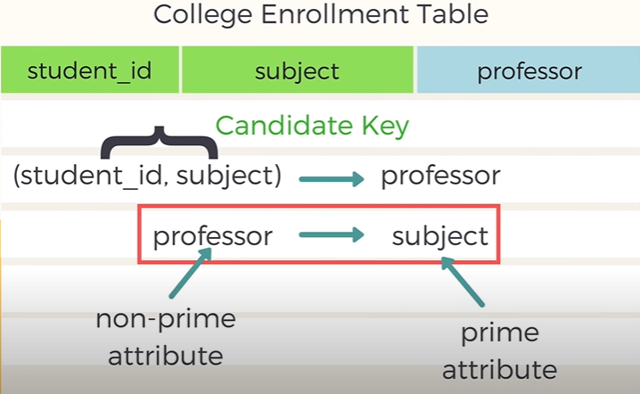
Normalization
Normalization - Boyce - Codd Normal Form (BCNF)
Example: consider the following table
Here, professor (non-prime attribute) determines subject (prime attribute), so the table is not in BCNF

Slide 57

Normalization
Normalization - Boyce - Codd Normal Form (BCNF)
To convert the table in to BCNF, we have to split the table into two

